Slide 1
What is Python?
An all-purpose, general language that works on multiple platforms
High level and easy to learn.
More commonly used for machine learning & predictive modeling.
Open source and free to learn and use more commonly by developers.

Slide 2
Why Is Python So Popular?
Java
public class Main { public static void main(String[] args) { System.out.println("hello world"); } }
Python
print(‘hello world’)

Slide 3
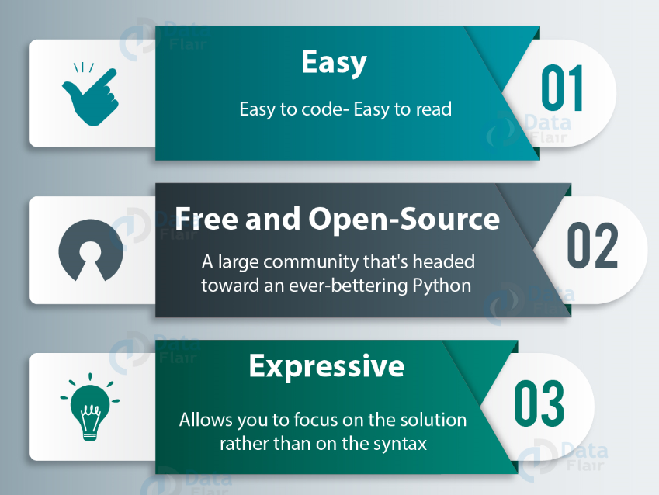
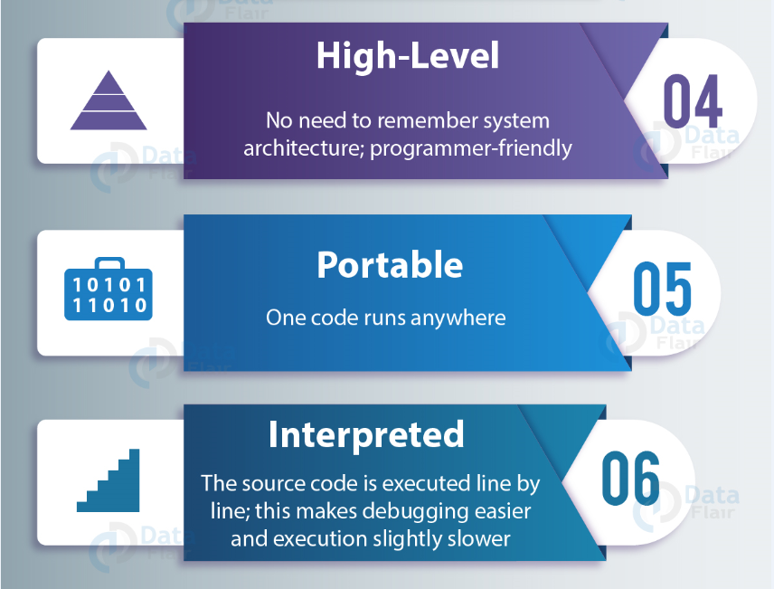
Advantages of Python

Slide 4
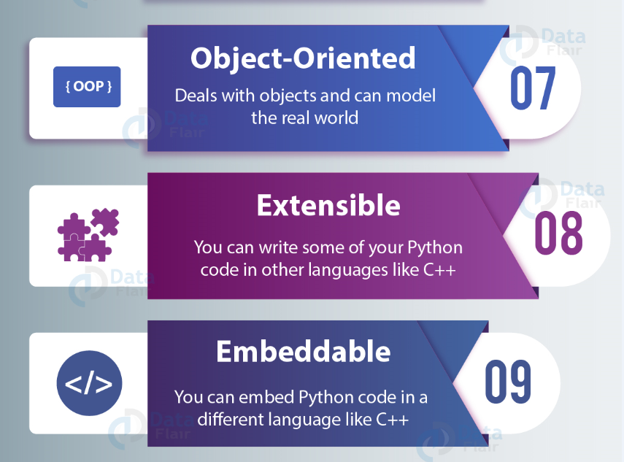
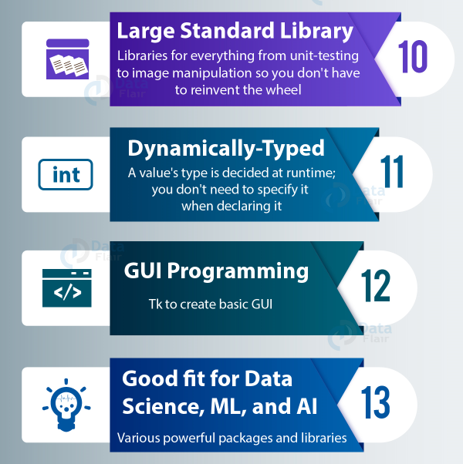
Advantages of Python

Slide 5
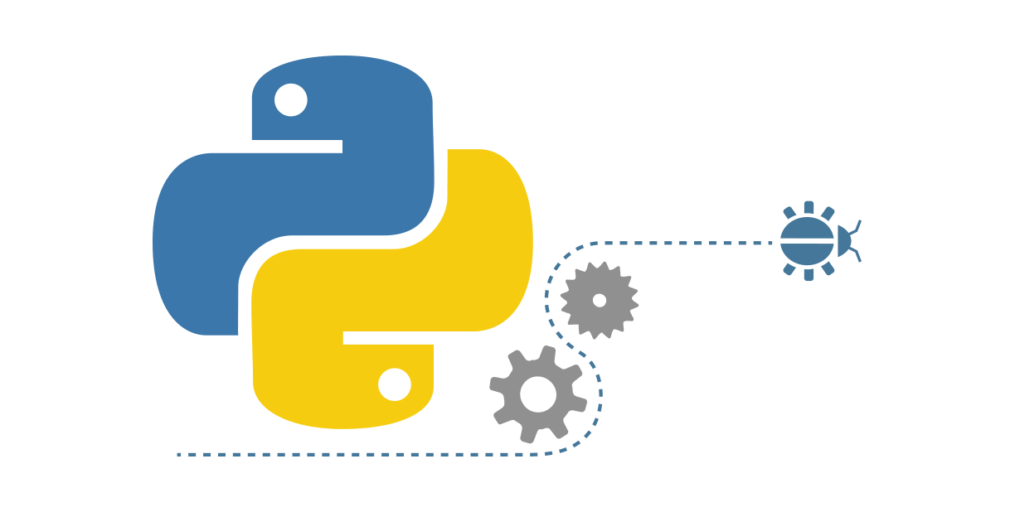
Python Environment Setup and Essentials
In initial lectures of Python training, the focus will be on logic building and getting familiar with basic programming fundamentals.
Getting started
Operators
Conditions statements
Looping in Python

Slide 6
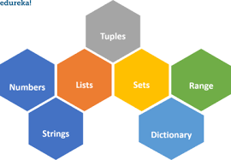
Data Types in Python
After first fundamental’s part, work on basic Python concepts like strings and lists, along with quizzes to check your understanding. Towards the end of the section, we'll learn about more involved topics like loops and functions and do a lot of coding exercises.
Data Types in python
Strings
Lists And Tuples
Dictionary, Sets

Slide 7

Functions & Modules
The topics covered will be the backbone for the rest of the course and are also crucial for an interview perspective.
Functions ,
Variables and their Scope
Modules
Object Orientation in Python (OOPs)

Slide 8

Other Libraries
Here we will be learning more import concepts of File and Exception handling. This part gives you flexibility to work with any kind of files and handle any error all together.
File Handling
Pickle & OS Module
Regular expression
DateTime Module
Exception Handling

Slide 9
Installation of Python on Windows / Linux
For Windows
Download Python from www.python.org
2. For Linux
Python is already install on Linux when Operating System is getting installed

Slide 10
Anaconda Installation
Download and install Anaconda (windows version) from
https://www.anaconda.com/download/

Slide 11
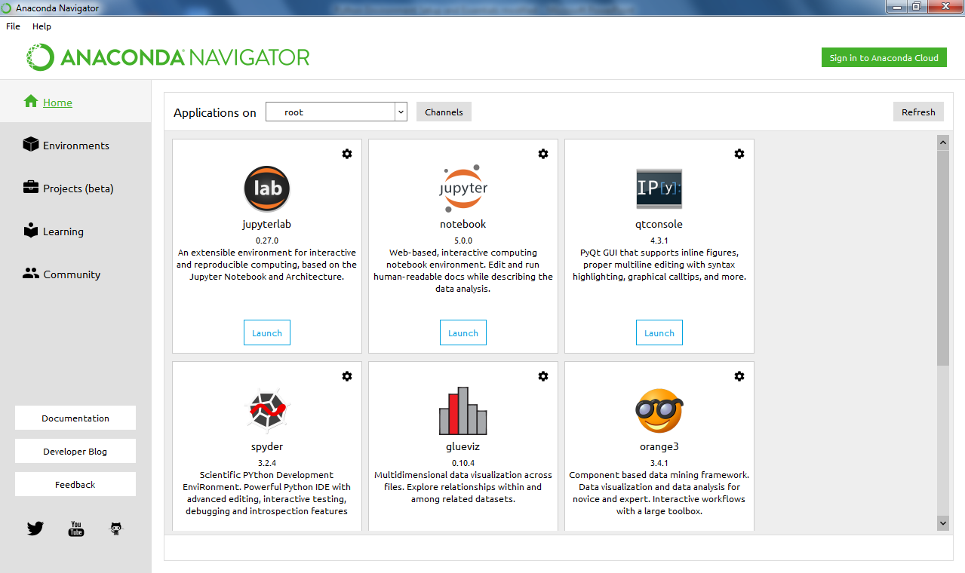
Anaconda Navigator

Slide 12
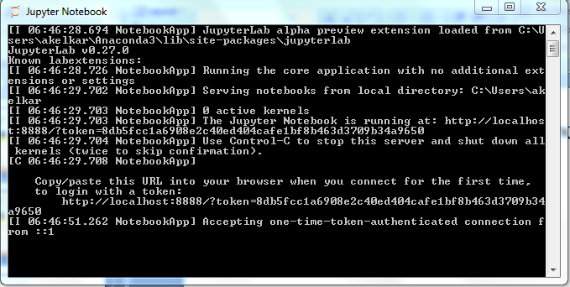
Working with Jupyter Notebook

Slide 13
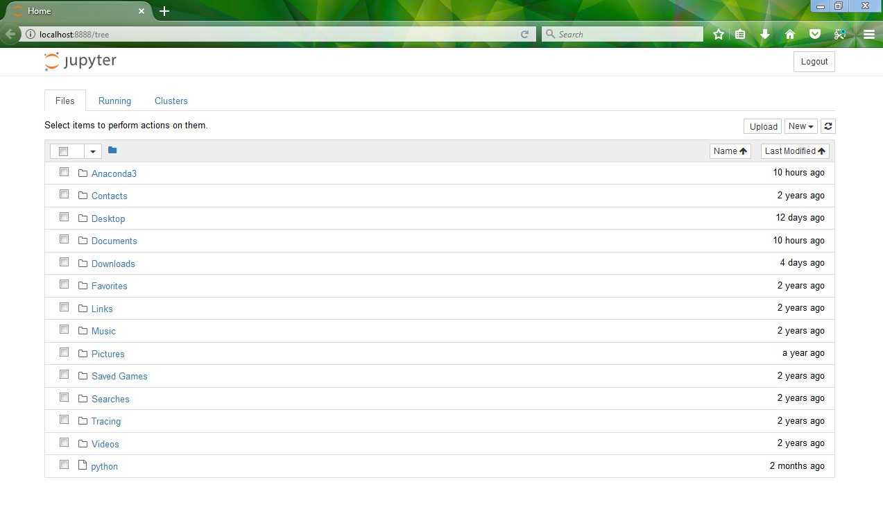
Working with Jypyter Notebook

Slide 14
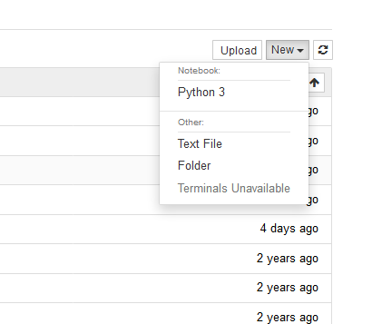
Working with Jypyter Notebook

Slide 15
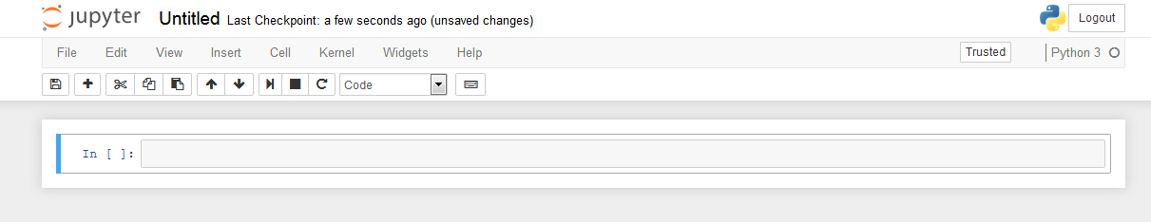
Working with Jypyter Notebook

Slide 16
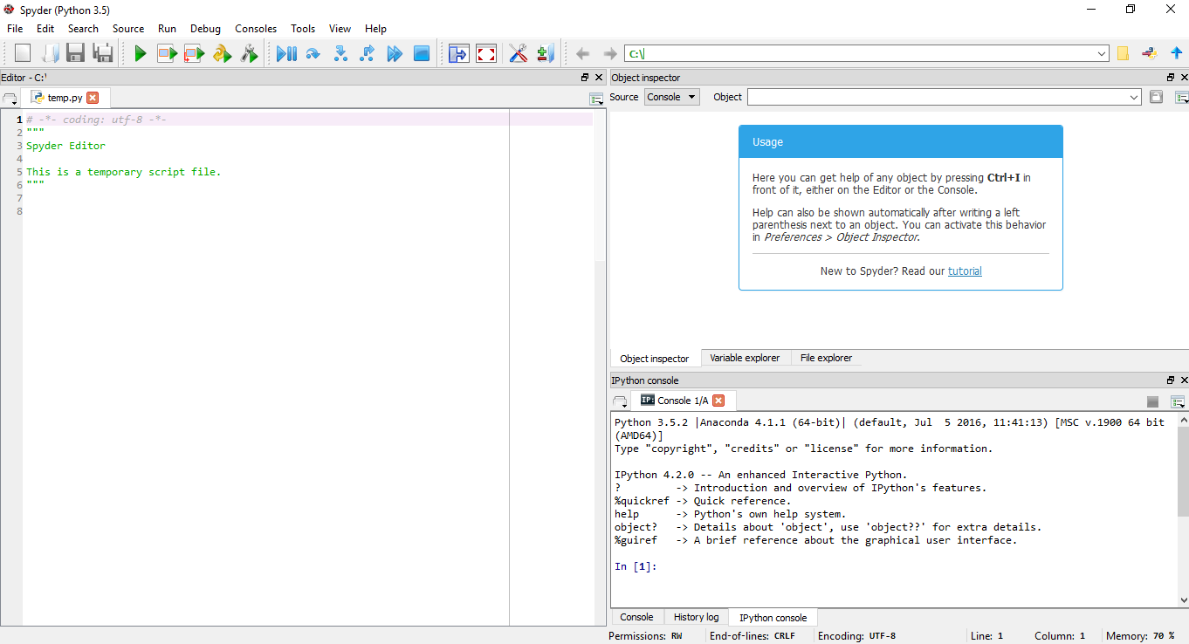
Spyder IDE
The usual Spyder screen has 3 windows
The Python Script(s) View
Object/Variable/File explorer
Console

Slide 17
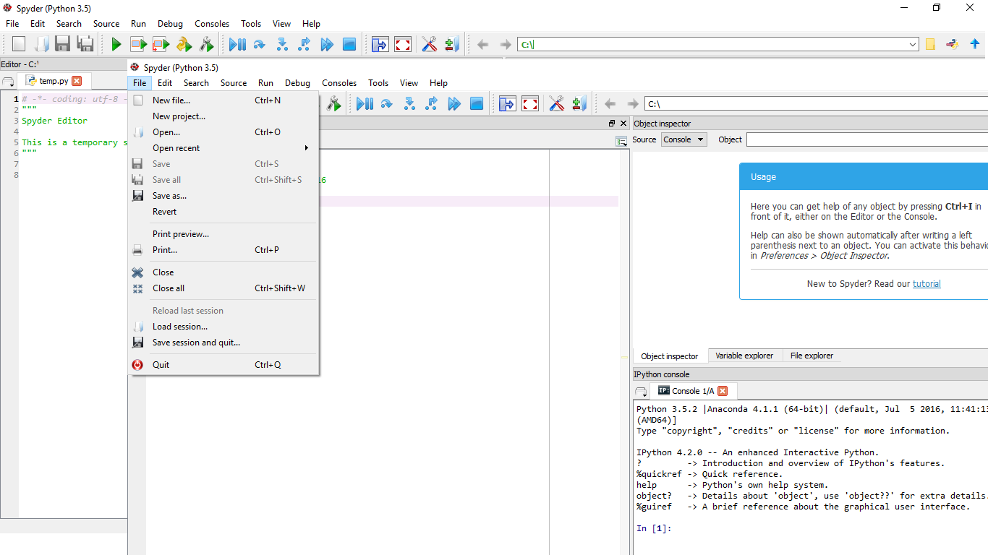
Spyder Screen: Python Script
To create a new Python script you can either go to File -> New File, or simply press Ctrl + N. Make sure to save the script.

Slide 18
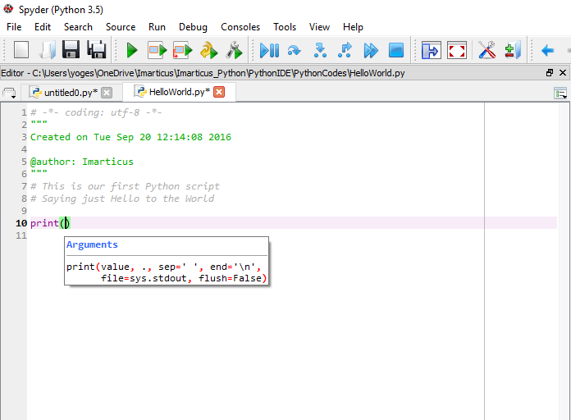
Spyder Screen: Environment

Slide 19
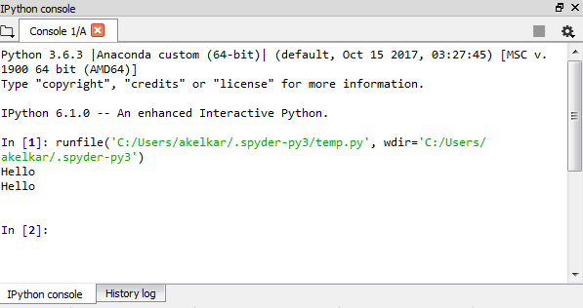
Spyder Screen: Console
The Console is where you may enter, interact with and visualize data, inside a command interpreter.
All the commands entered in the console are executed in a separate process, thus allowing the user to interrupt any process at any time.

Slide 20
Basics of Python

Slide 21
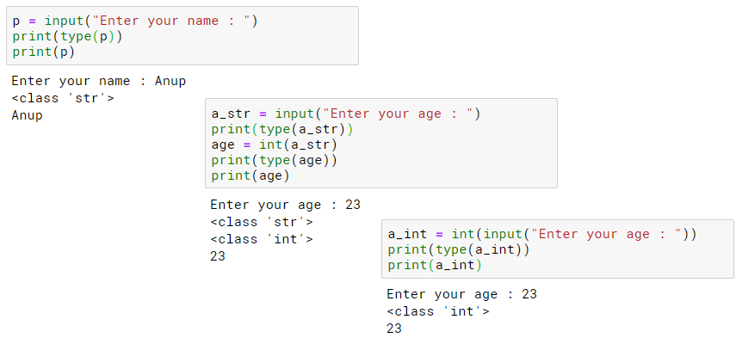
User Input and Output

Slide 22
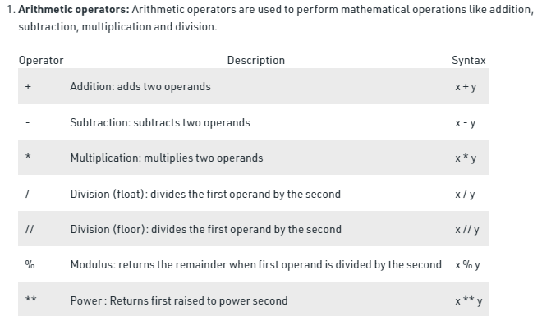
Operators in Python

Slide 23
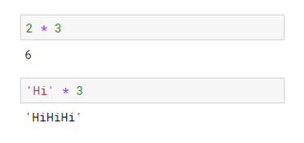
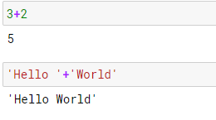
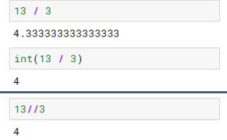
Operators in Python

Slide 24
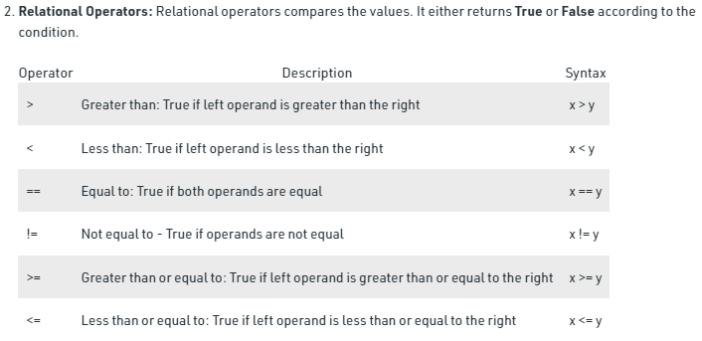
Operators in Python

Slide 25
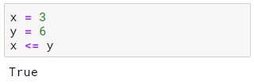

Operators in Python

Slide 26
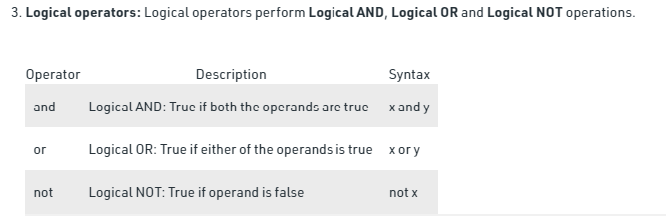
Operators in Python

Slide 27
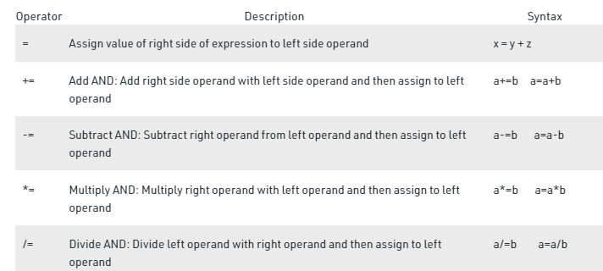
Operators in Python

